Slide 1
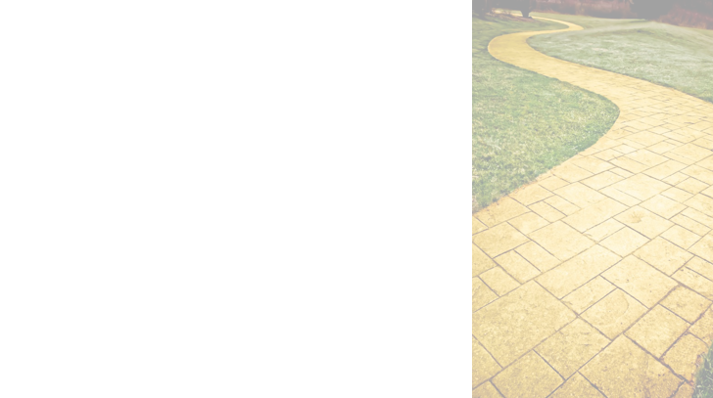
Ally: Accessibility training, and remediation, and tracking, Oh my!
Jess Thompson, WA State Board
Zach Lattin, Clark College
Nicolaas Matthijs, Blackboard
http://bit.ly/WA-allypilot

Slide 2
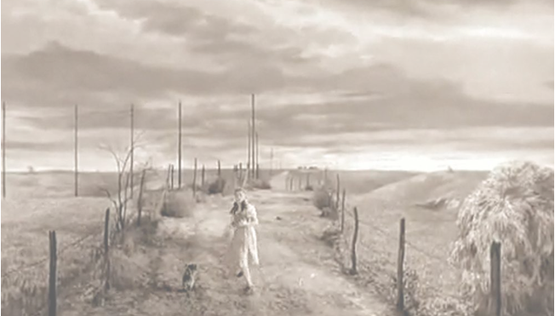
Lay of the Land

Slide 3
Jess Thompson
Program Administrator, Accessible Technology Initiatives
Washington State Board for Community & Technical Colleges
Role(s):
Accessibility Instigator/Agitator/Evangelist
Responsibilities:
Faculty/system accessibility training
Accessible instructional technologies
Liaise between eLearning & Disability Support Services
Serve on Committee for Accessible Technology Oversight

Slide 4
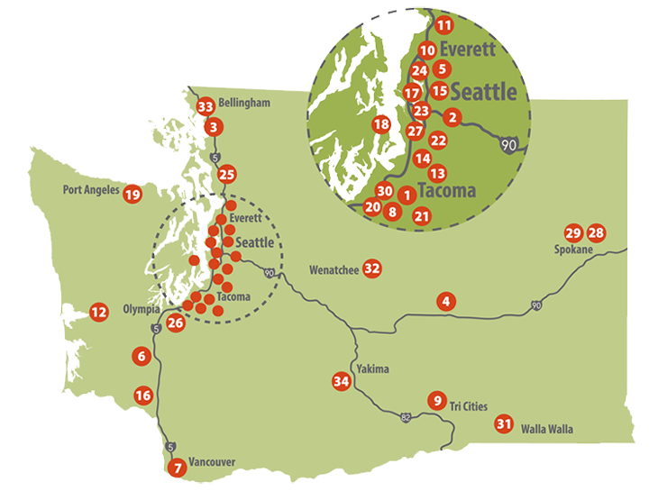
State Board for Community & Technical Colleges (SBCTC)
State agency oversees a system of 34 community and technical colleges

Slide 5
Washington CTCs
Almost 400,000 students, 180,000 FTE.
7,300 teaching faculty.
Up to 40% of FTE are in online courses.
Online enrollments continue to rise even as overall CC enrollment is down.

Slide 6

Anxiety Around Accessibility

Slide 7
WA Higher Ed Accessibility Landscape
State Board Accessible Technology Policy (approved March 2016) reinforced existing legal requirements.
WA State Office of the CIO Accessible Technology Policy (August 2016) established coordinator roles and deadlines for plans.
Both policies raised awareness and provided momentum, but increased questions (and anxiety) about how to meet requirements.

Slide 8
SBCTC Support for Accessibility
UDOIT app enabled for all Canvas instances at all CTCs.
Statewide captioning contract and development of Caption Hub to support discounted pricing.
Accessibility 101 Training on basics of document and Canvas HTML accessibility.
Webinars on Accessibility.

Slide 9
WA CTC Gaps in Accessibility
UDOIT tool not widely used, had many false positives, lacked coordinated faculty training.
Accessibility 101 training exposed deep pent up demand.
Look for solutions that are more proactive, that don’t require faculty training as a primary strategy.

Slide 10

Somewhere over the rainbow...

Slide 11
Nicolaas Matthijs
Spent a lot of time in higher ed
University of Cambridge
Georgia Tech
UC Berkeley
Co-founders of Ally
Product Manager, Blackboard Ally

Slide 12
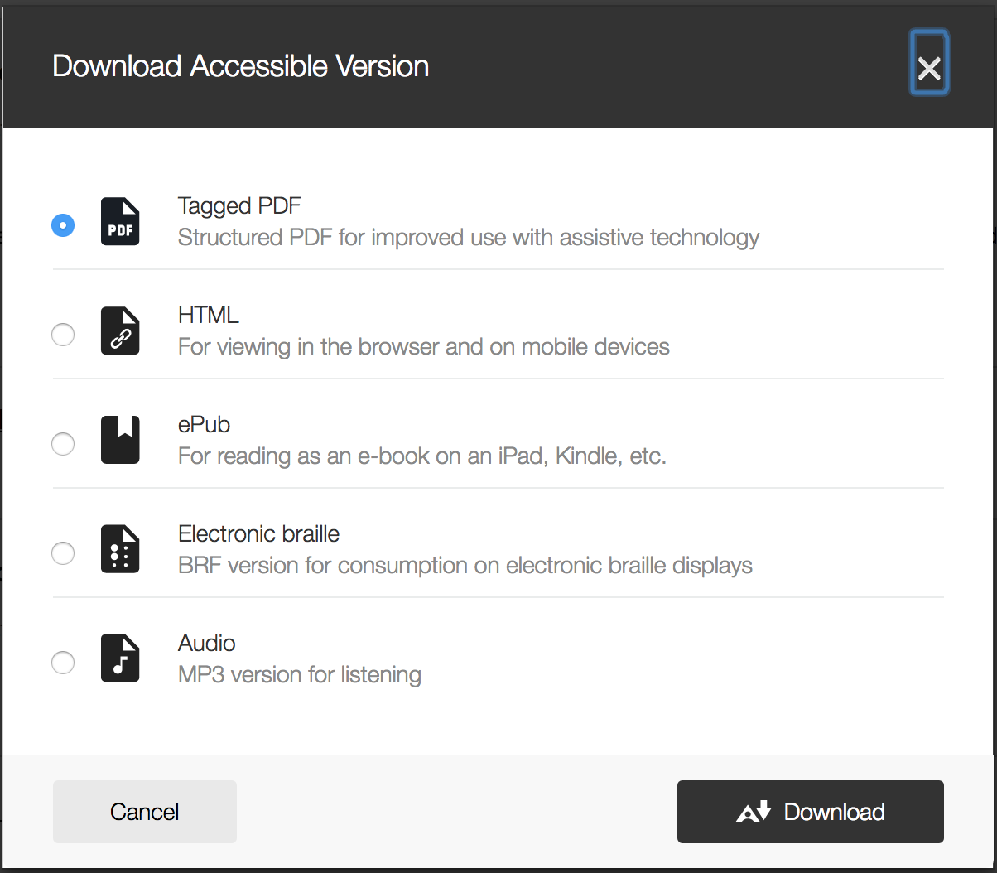
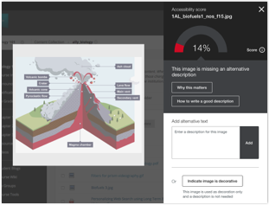
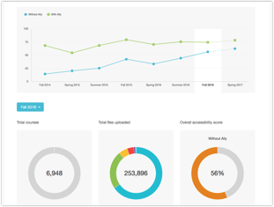
Enter Ally
Alternative Accessible Versions
Automatically checks for accessibility issues and generates alternative accessible formats
Instructor Feedback
Guides instructors on how to improve the accessibility of their course content and alters future behavior
Institutional report
Provides detailed data and insights to help further improve course content accessibility at the institution

Slide 13
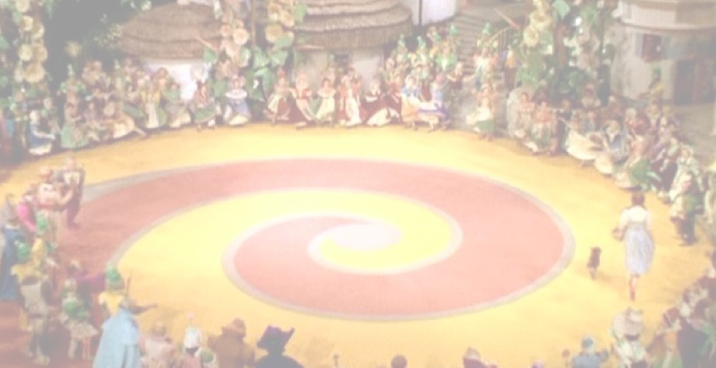
Venturing into Oz

Slide 14
SBCTC Ally Pilot
8 community and technical colleges
5 colleges provided Ally in all courses.
3 colleges provided Ally in selected courses based on willing faculty or courses with a student enrolled who has an accommodation.

Slide 15

We’re off to see the wizard... pilot

Slide 16
Zach Lattin
Clark’s Assistive Tech / Accessibility specialist position:
Student AT trainings and consults.
Oversee alt format process, including tailoring formats to students’ devices.
Faculty and staff accessibility trainings.
Web accessibility testing
Support implementation of Clark’s Accessibility policy.

Slide 17
Clark College’s Accessibility Needs
Across the street from The Washington State School for the Blind and very close to The Washington State School for the Deaf.
Ten to Twenty-five students with visual impairments per quarter: Screen- reader users, Braille readers, all of these students utilize alternative format accommodation very heavily.
Ten to fifteen deaf / hard of hearing students per quarter:
These students utilize captioning and ASL interpreters.

Slide 18
Ally Rollout Strategy
Partnership Between E-Learning and DSS:
DSS ran reports in AIM to identify courses with students with accessibility needs.
Ally was included in only those courses from the report, not campus-wide.
Three-quarter pilot: Winter 2017 - Summer 2017

Slide 19
Ally Rollout Strategy cont’d
In-person Faculty, Staff, and Student Trainings:
Many informal one-on-one phone conversations and walkthroughs on remediating content.
Two trainings attended by 40-50 staff members each.
Ten to fifteen student trainings on using Ally to create their preferred type of alt format.

Slide 20
Clark’s Alt Format Process
Students let Clark DSS know they have registered for classes.
DSS staff contacts instructor for reading list.
DSS staff acquires texts from publisher or high-speed scans textbooks if not available.
DSS staff produces accessible alternate format based on instructor-provided schedule.
Alt format editors use Ally’s tools in process of creating alt format for students.
Student picks up format.

Slide 21
Impacts of Ally
People are more proactive
“Accessibility is in the air.”
Fewer people coming in with emergencies, fewer inaccessible PDFs
DSS staff and student workers are using Ally to create alt format for students
Kindled a conversation about accessibility

Slide 22

Findings from the Pilot Group

Slide 23
Pilot Feedback Survey
40 faculty from 4 pilot schools
Some piloted in live classes, others in master course
Disciplines:
STEM - 13
Humanities - 8
Business - 7
ABE/ESL - 5
Library - 2
Other - 5

Slide 24
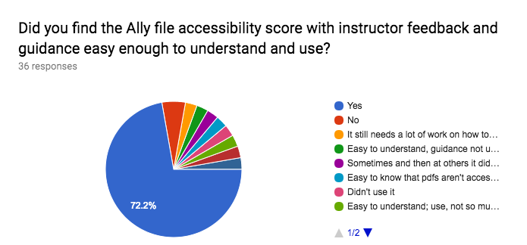
Ease of Use
“I really liked it. It was very easy to see where I was missing alternative text and which files I had there that were not accessible. I don't know if we can keep it, but I really like it and hope we can!”

Slide 25
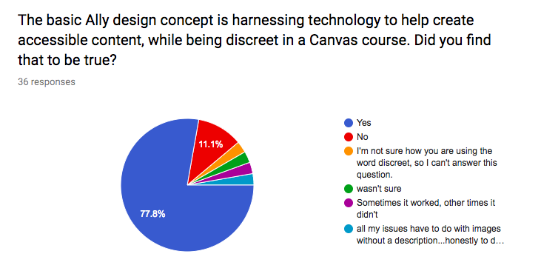
Discreet Presence
“I was delighted to see the recent changes in Canvas that make it easy to see whether documents and images are accessible.”

Slide 26
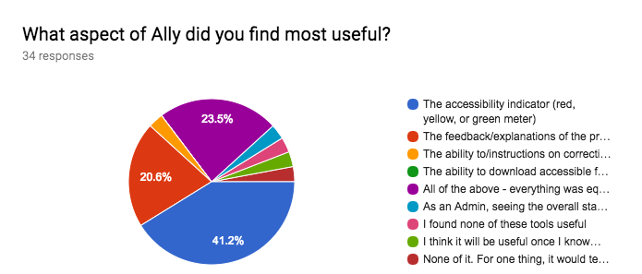
Useful Features
“I loved seeing the indicator turn green on my document. I think the symbol is a great reinforcer. I know it's all about the student, but that green indicator made me even more pleased with my effort.”

Slide 27
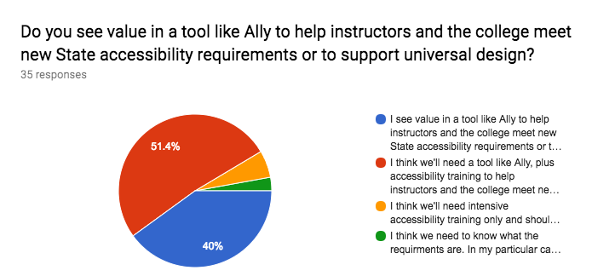
Need for Training
“I don't think this tool is at all useful unless you've received accessibility training. Without taking the SBCTC course on accessibility, I would have had no idea what any of the suggestions meant.”

Slide 28
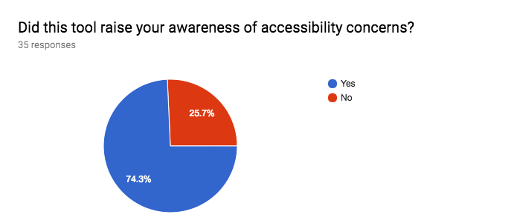
Raising Awareness
“Instructors are learning how to make accessible content; accessibility is starting to be demystified and make good design sense for instructors; faculty felt relieved something is there as needed if students can't access files.”

Slide 29
Canvas Admin Experiences
First time they had seen a comprehensive list of issues.
Requires learning in order to answer faculty questions (e.g., PDF handling).
Exposed need to develop processes and policies to address the issues.

Slide 30
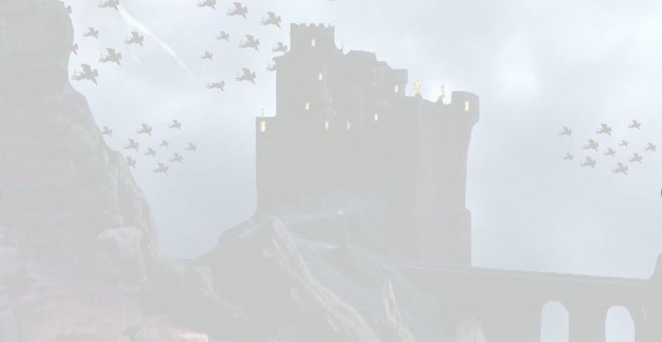
Watch out for flying monkeys!

Slide 31
Lessons Learned
Importance of marketing and communication
Many faculty ignored indicators at those colleges that enabled Ally in all courses
Faculty nervous that students could see the red indicators (they can’t)
Faculty nervous about how it impacts live course (about half tested in sandbox first)
Need for training
Most faculty felt Ally was a useful tool to support accessibility, but stressed the need for additional training on accessible content creation.

Slide 32
Lessons Learned cont’d
Roll out strategies
Limiting access to courses where students have disclosed a disability proved problematic
Concerns regarding Institutional Report
Admins anticipated faculty being uncomfortable with use of the institutional report

Slide 33
Lessons Learned cont’d
Parallel rollouts impacted faculty perception of Ally
“It was awful. It just appeared one day, I did not know anything about it, and content that I had created myself became unavailable. There was no information beforehand, I had students emailing me and calling me to say they could not access required files, etc.”
(The eLearning office had enabled a copyright add on, then disabled it, took access away from content.)

Slide 34

Post Pilot Update

Slide 35
Where are we now?
Pilot was followed by system-wide license.
33 of 34 opted in
Ally is being used by student workers to quickly identify issues and fix them.
Brainstorming how to leverage institutional report and data.
Used to gamify accessibility.

Slide 36
Learn More About Ally
Automating accessibility within the learning management system (Thursday 8am - WB IV)
Ally at CSU Chico
Creating an accessible environment and enabling student success (Thursday 9.15am - WB III)
Detailed demo of Ally
http://bit.ly/allyincanvas

Slide 37
Questions?
Jess Thompson: jess.thompson@sbctc.edu
Zach Lattin: zlattin@clark.edu
Nicolaas Matthijs: nicolaas.matthijs@blackboard.com

